Slide 1
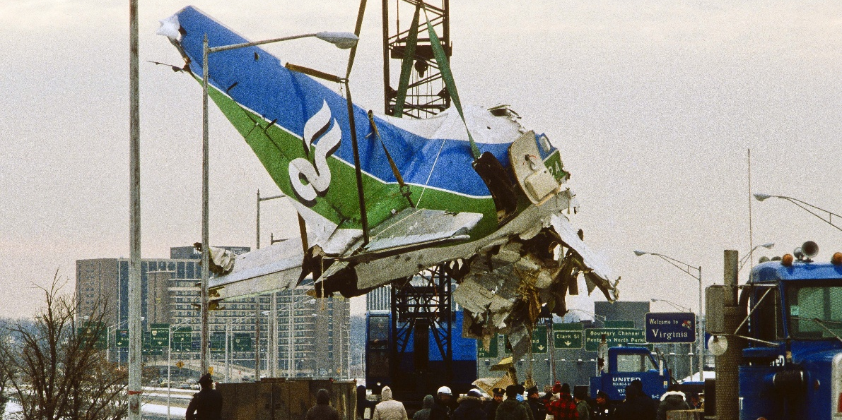



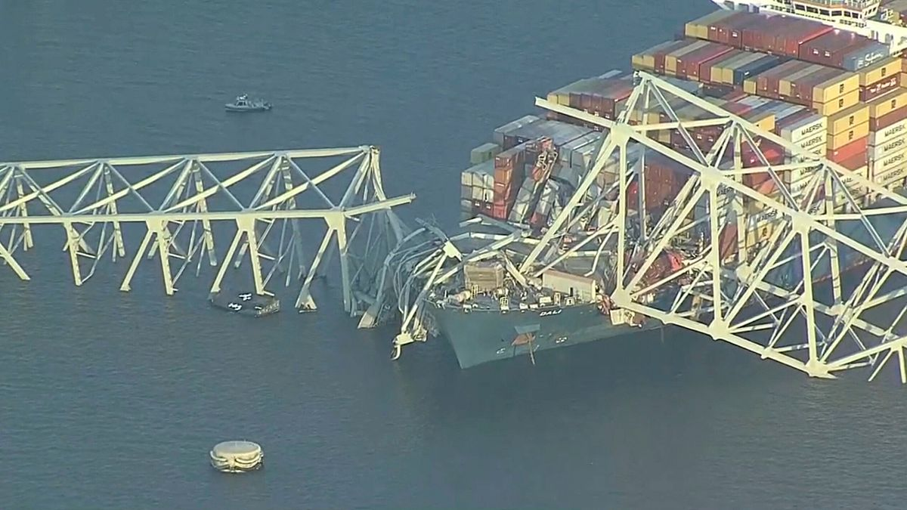
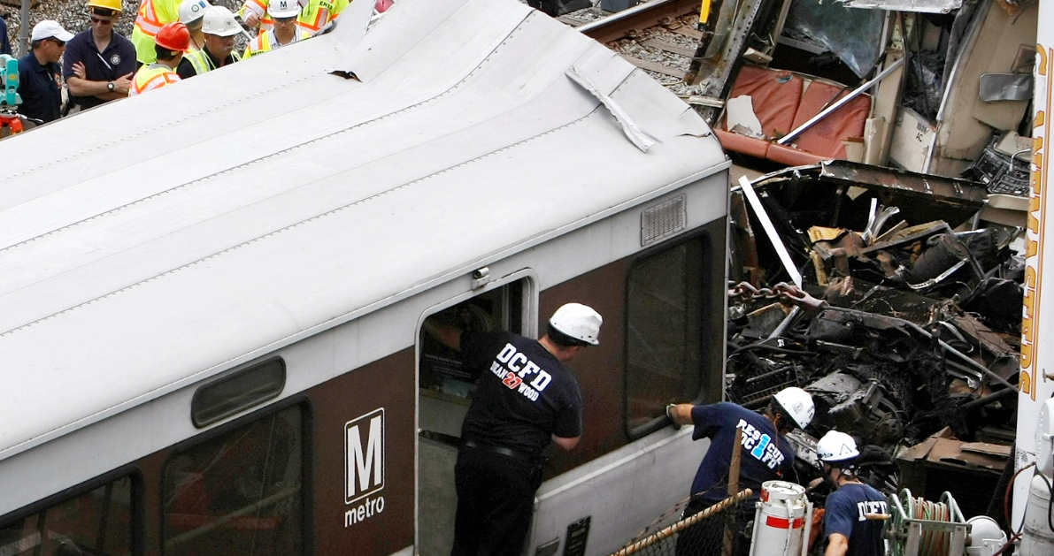
Region 20 Interoperability Template

Slide 2
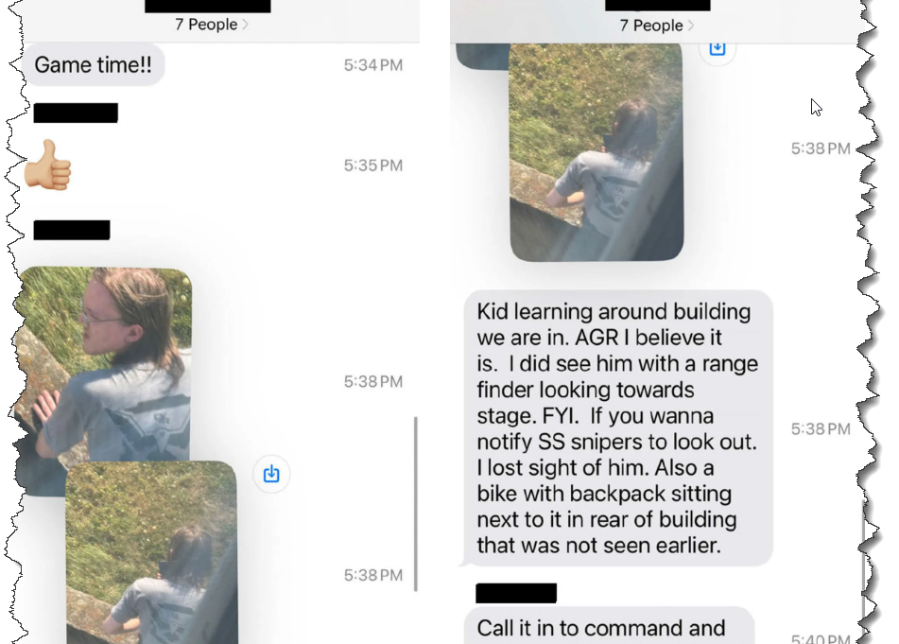

Reality of a 21st century interoperability problem
90 minutes
We (public safety) have created a mess. We have made Interoperable resources too difficult for the end user to navigate.
Because of this we are truly moving away from an interoperable space. This is caused by inconsistency and siloing across agencies, and the fear of the end user not being able to communicate. “They will always take warm and fuzzy over cold and complicated”.
Therefore, the end user has been relegated to using consumer grade devices to communicate critical information at times of critical need. These devices are largely not appropriate or timely enough for the mission.
An example is the NCR. 3000 modes in the radio and we have used them all.. That’s 3000 places for the end user to get lost.
The R20 I/O Template aims to correct the sins of the past by standardizing the most common interoperable tools across the whole region. This begins by placing national, and local interoperable tools in every subscriber in the same consistent format.
90 minutes from the time suspect was recognized until shots were fired

Slide 3

Why a standardized interoperability template
Provides uniformity of channel labeling throughout Region 20 for repeated and direct/simplex use
Nomenclature is based upon national channel naming standards
Introduces new deployable trunking channels; up to 28 talkgroups
Provides six 700 MHz frequencies for regionwide RINS simplex use; these frequencies are NOT limited to the NCR; however, are secondary to deployable trunking use
Standardizes low power 700 MHz frequency in Region 20 as to analog and digital use. Low power channels can be used throughout Region 20

Slide 4
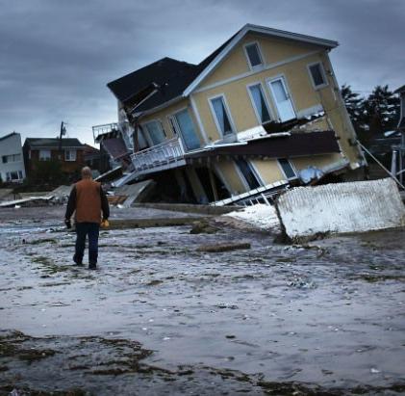
Why follow nationwide standards and add new zones
The template adds many zones to radios; are they necessary?
Today’s public safety world faces many dramatic challenges, and first responders may be required to relocate to new areas of operation.
Having these zones in your radios prepares first responders to meet unknown communications challenges.
If deployed to new areas, radios are pre- programmed to communicate and may not require on-site reprogramming to meet the interoperable need.

Slide 5
Region 20 Interoperability Template
Zone Name | Pos 1 | Pos 2 | Pos 3 | Pos 4 | Pos 5 | Pos 6 | Pos 7 | Pos 8 | Pos 9 | Pos 10 | Pos 11 | Pos 12 | Pos 13 | Pos 14 | Pos 15 | Pos 16
Standard Template | Standard Template | Standard Template | Standard Template | Standard Template | Standard Template | Standard Template | Standard Template | Standard Template | Standard Template | Standard Template | Standard Template | Standard Template | Standard Template | Standard Template | Standard Template | Standard Template
800 IO | 8CALL90 | 8TAC91 | 8TAC91D | 8TAC92 | 8TAC92D | 8TAC93 | 8TAC93D | 8TAC94 | 8TAC94D | BLANK | BLANK | BLANK | BLANK | BLANK | BLANK | BLANK
RINS 700D | RINS11D | RINS12D | RINS13D | RINS14D | RINS15D | RINS16D | RINS21LD | RINS22LD | RINS23LD | RINS24LD | RINS25LA | RINS26LA | RINS27LA | RINS28LA | RINS29LA | BLANK
RINS 800 | RINS1 | RINS1D | RINS 2 | RINS2D | RINS 3 | RINS3D | RINS 4 | RINS4D | RINS 5 | RINS5D | RINS 6 | RINS6D | BLANK | BLANK | BLANK | BLANK
700 IO D | 7AG88D | 7TAC51D | 7TAC52D | 7TAC53D | 7TAC54D | 7TAC55D | 7TAC56D | 7TAC71D | 7TAC72D | 7TAC73D | 7TAC74D | 7TAC75D | 7TAC76D | 7GTAC57D | 7GTAC77D | BLANK
700 IO R | 7CALL50 | 7TAC51 | 7TAC52 | 7TAC53 | 7TAC54 | 7TAC55 | 7TAC56 | 7TAC71 | 7TAC72 | 7TAC73 | 7TAC74 | 7TAC75 | 7TAC76 | 7GTAC57 | 7GTAC77 | 7CALL70
DEPLOY ZZ | CALL ZZ | CMD ZZ | TAC ZZ3 | TAC ZZ4 | TAC ZZ5 | TAC ZZ6 | TAC ZZ7 | TAC ZZ8 | TAC ZZ9 | TAC ZZ10 | TAC ZZ11 | TAC ZZ12 | TAC ZZ13 | TAC ZZ14 | TAC ZZ15 | EMER ZZ
DEPLOY YY | CALL YY | CMD YY | TAC YY3 | TAC YY4 | TAC YY5 | TAC YY6 | TAC YY7 | TAC YY8 | TAC YY9 | TAC YY10 | TAC YY11 | TAC YY12 | TAC YY13 | TAC YY14 | TAC YY15 | EMER YY
700 LAW | 7LAW61 | 7LAW61D | 7LAW62 | 7LAW62D | 7LAW81 | 7LAW81D | 7LAW82 | 7LAW82D | 7MOB59 | 7MOB59D | 7MOB79 | 7MOB79D | BLANK | BLANK | BLANK | BLANK
700 FIRE | 7FIRE63 | 7FIRE63D | 7FIRE64 | 7FIRE64D | 7FIRE83 | 7FIRE83D | 7FIRE84 | 7FIRE84D | 7MOB59 | 7MOB59D | 7MOB79 | 7MOB79D | BLANK | BLANK | BLANK | BLANK
700 MED | 7MED65 | 7MED65D | 7MED66 | 7MED66D | 7MED85 | 7MED85D | 7MED86 | 7MED86D | 7MOB59 | 7MOB59D | 7MOB79 | 7MOB79D | BLANK | BLANK | BLANK | BLANK
Optional Tempate | Optional Tempate | Optional Tempate | Optional Tempate | Optional Tempate | Optional Tempate | Optional Tempate | Optional Tempate | Optional Tempate | Optional Tempate | Optional Tempate | Optional Tempate | Optional Tempate | Optional Tempate | Optional Tempate | Optional Tempate | Optional Tempate
MD CALL | MD CALL | MD TAC 1 | MD TAC 2 | MD TAC 3 | MD TAC 4 | MD TAC 5 | MD TAC 6 | MD TAC 7 | MD TAC 8 | MD TAC 9 | MD TAC 10 | MD TAC 11 | MD TAC 12 | MD TAC 13 | MD TAC 14 | MD TAC 15
MD LAW | MD CALL | MD LAW 1 | MD LAW 2 | MD LAW 3 | MD LAW 4 | MD LAW 5 | MD LAW 6 | MD LAW 7 | MD LAW 8 | MD LAW 9 | MD LAW 10 | MD LAW 11 | MD LAW 12 | MD LAW 13 | MD LAW 14 | MD LAW 15
MD EVENT | MD CALL | MD EV‐1 | MD EV‐2 | MD EV‐3 | MD EV‐4 | MD EV‐5 | MD EV‐6 | MD EV‐7 | MD EV‐8 | MD EV‐9 | MD EV‐10 | MD EV‐11 | MD EV‐12 | MD EV‐13 | MD EV‐14 | MD EV‐15
USAWIDE | 7‐US‐01D | 7‐US‐02D | 7‐US‐03D | 7‐US‐04D | 7‐US‐05D | 7‐US‐06D | BLANK | BLANK | BLANK | BLANK | BLANK | BLANK | BLANK | BLANK | BLANK | BLANK

Slide 6
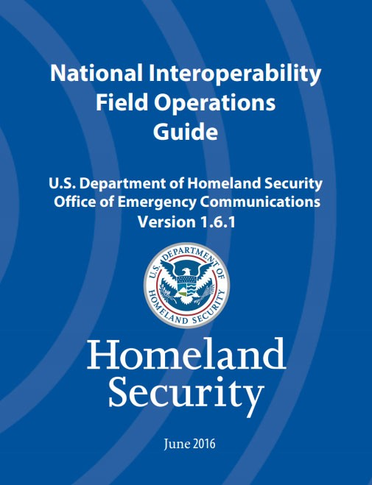
Built following National Interoperability Plans
By using national plans for radio labeling, the potential for confusion during extraordinary deployments within and outside of Region 20 is reduced
If temporarily deployed to the NCR, all Region 20 radios are labeled and configured in a uniform manner
Minimizes confusion during emergencies

Slide 7
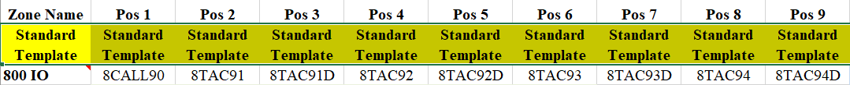
800 MHz Nationwide Interoperability Channels
The National Public Safety Planning Advisory Committee (NPSPAC) framework, developed in the late 1980s, was a response to a congressional directive to the FCC to create a national plan for public safety communications, ultimately leading to the allocation of 6 MHz of spectrum in the 800 MHz band for public safety use.
Appropriate interoperability communications “are not intended for routine, administrative, intra- agency (emphasis added) communications, but are to be reserved for coordination of multiple public safety entities.”²
Communications that are not “day to day” intra-agency uses; “any internal day-to-day communications on the 800 MHz mutual aid channels would be a violation of FCC rules.”³
Mobile and portable radios operating on the mutual aid channels shall employ an analog FM emission.⁴
Encryption may not be used on any of the interoperability or mutual aid calling channels.⁵

Slide 8
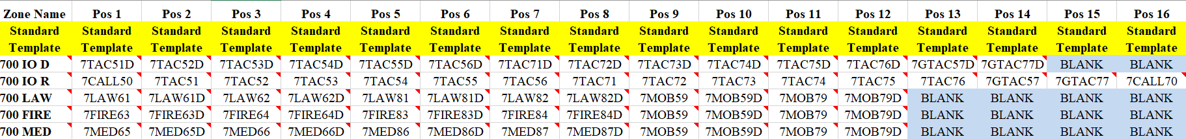
700 MHz Nationwide Interoperability Channels
The Region 20 template deviates from the nationwide plan slightly as to layout. In the NCR, there is an existing plan to use the 700 MHz nationwide tactical interoperability frequencies in the simplex mode for certain events. To support the NCR agencies, the use of these frequencies is divided by zone between simplex and repeater use. All other 700 MHz interoperability frequencies are placed into zones per the nationwide plan.

Slide 9
New 700 MHz Communications Resources
RINS 11D – 16D available for full power direct/simplex use when deployable trunking is not being used
Under FCC rules, 700 MHz low power frequencies can be used in an analog or digital mode
Zone Name | Pos 1 | Pos 2 | Pos 3 | Pos 4 | Pos 5 | Pos 6 | Pos 7 | Pos 8 | Pos 9 | Pos 10 | Pos 11 | Pos 12 | Pos 13 | Pos 14 | Pos 15 | Pos 16
Standard Template | Standard Template | Standard Template | Standard Template | Standard Template | Standard Template | Standard Template | Standard Template | Standard Template | Standard Template | Standard Template | Standard Template | Standard Template | Standard Template | Standard Template | Standard Template | Standard Template
RINS 700 | RINS11D | RINS12D | RINS13D | RINS14D | RINS15D | RINS16D | RINS21L | RINS22L | RINS23L | RINS24L | RINS25L | RINS26L | RINS27L | RINS28L | RINS29L | BLANK
RINS21L – 24L are configured as low power digital
RINS25L – 29L are configured in the low power analog mode
RINS 21L - 29L power is limited to two watts ERP
Low power frequencies can be used throughout Region 20; no geographical restriction

Slide 10

800 MHz RINS Channels
The 800 MHz RINS channels require a specific FCC license
Use of the RINS frequencies is limited to the National Capital Region
The frequencies cannot be used throughout the Region as they are also licensed extensively in proximate states
These frequencies are included in the code plug in the event that a Region 20 licensee goes to the National Capital Region and requires interoperability with a licensed user and the licensed user permits operation under their license for interoperability

Slide 11
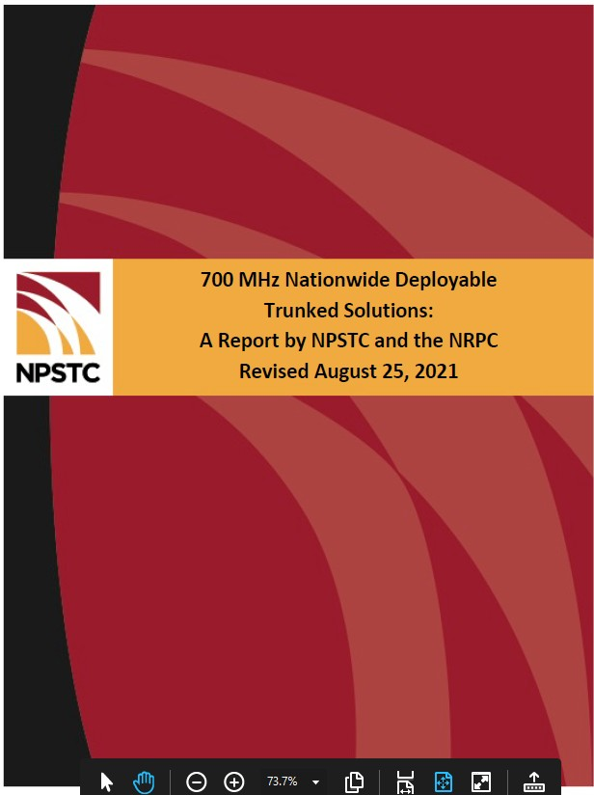
Deployable Trunking
Supports planned special events or unplanned extraordinary incidents with limited incident- based radio coverage
Removes extraordinary incident or special event radio traffic from a local communications system and maintains capacity and resource availability for first responders engaged in jurisdictional operations
Provides 28 talkgroups for command and tactical purposes
Can be accessed by a jurisdiction’s 9-1-1 Center or command vehicles through control stations
Examples of coverage to portable radios are depicted on the following pages

Slide 12
Deployable Trunking
28 command & tactical talkgroups for deployable trunking
Zone Name | Pos 1 | Pos 2 | Pos 3 | Pos 4 | Pos 5 | Pos 6 | Pos 7 | Pos 8 | Pos 9 | Pos 10 | Pos 11 | Pos 12 | Pos 13 | Pos 14 | Pos 15 | Pos 16
Standard Template | Standard Template | Standard Template | Standard Template | Standard Template | Standard Template | Standard Template | Standard Template | Standard Template | Standard Template | Standard Template | Standard Template | Standard Template | Standard Template | Standard Template | Standard Template | Standard Template
ZZ DEPLOY | CALL ZZ | CMD ZZ | TAC ZZ 3 | TAC ZZ 4 | TAC ZZ 5 | TAC ZZ 6 | TAC ZZ 7 | TAC ZZ 8 | TAC ZZ 9 | TAC ZZ 10 | TAC ZZ 11 | TAC ZZ 12 | TAC ZZ 13 | TAC ZZ 14 | TAC ZZ 15 | EMER ZZ
YY DEPLOY | CALL YY | CMD YY | TAC YY 3 | TAC YY 4 | TAC YY 5 | TAC YY 6 | TAC YY 7 | TAC YY 8 | TAC YY 9 | TAC YY 10 | TAC YY 11 | TAC YY 12 | TAC YY 13 | TAC YY 14 | TAC YY 15 | EMER YY
When deployable trunking is not being used, the six 700 MHz frequencies can be used throughout the Region as 700 MHz full power simplex frequencies; these simplex frequencies are not limited to the NCR area; RINS11D – RINS16D

Slide 13
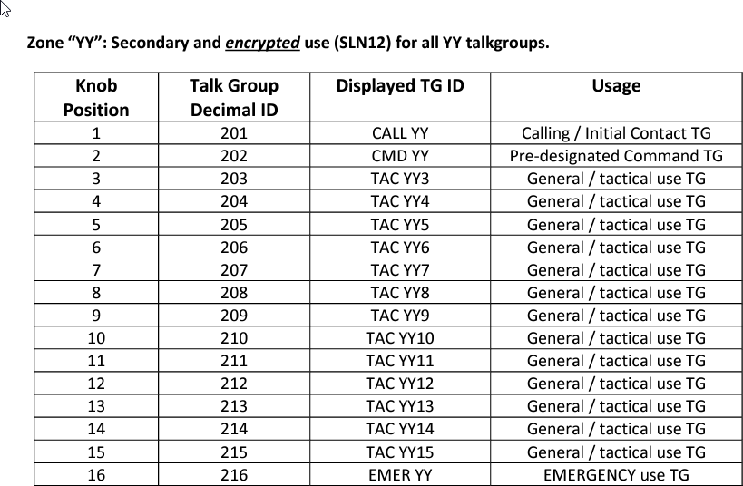
Deployable Trunking
As of the August 2021 revision of the National Plan zone YY has been approved for encrypted use:

Slide 14
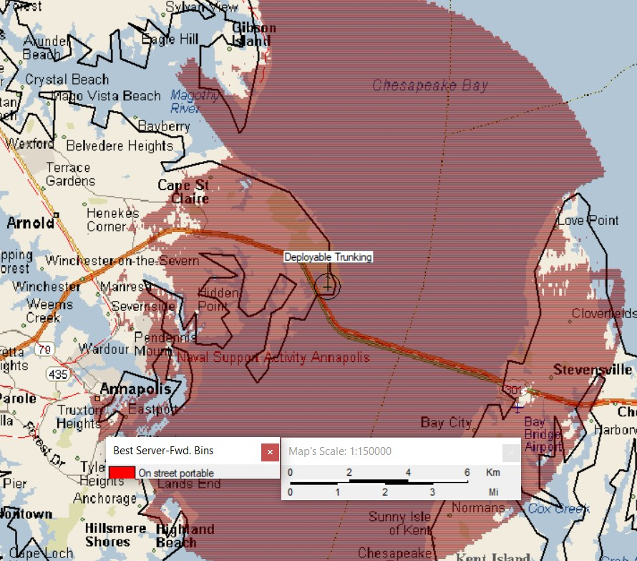
Example of Portable - Deployable Trunking Range
Sandy Point
Propagation based upon: 40 watts RF output
5.9 dB gain antenna mounted at 66’ AGL
2.5 watt portable radio

Slide 15
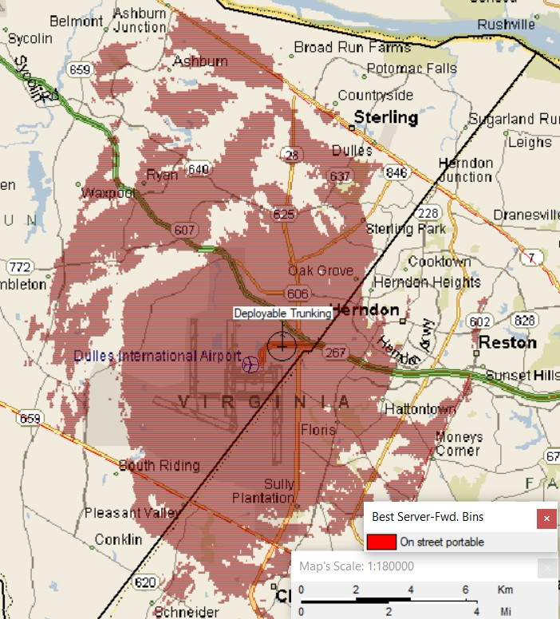
Example of Portable - Deployable Trunking Range
Dulles International Airport
Propagation based upon: 40 watts RF output
5.9 dB gain antenna mounted at 66’ AGL
2.5 watt portable radio

Slide 16

Explanation of Optional Zones
The Maryland FiRST (MD Call/MD TAC) and related new State talkgroups may only be used with the permission of the State of Maryland Radio Control Board.
USAWIDE channels are the three low power 700 MHz frequencies that can be used by any eligible Part 90 first responder agency with a FCC license anywhere in the United States.
To obtain a license for these frequencies, an applicant applies directly to the FCC through an approved frequency coordinator.
Region 20 approval is not required.
Federal interoperability frequencies can be added by authorized users.

Slide 17
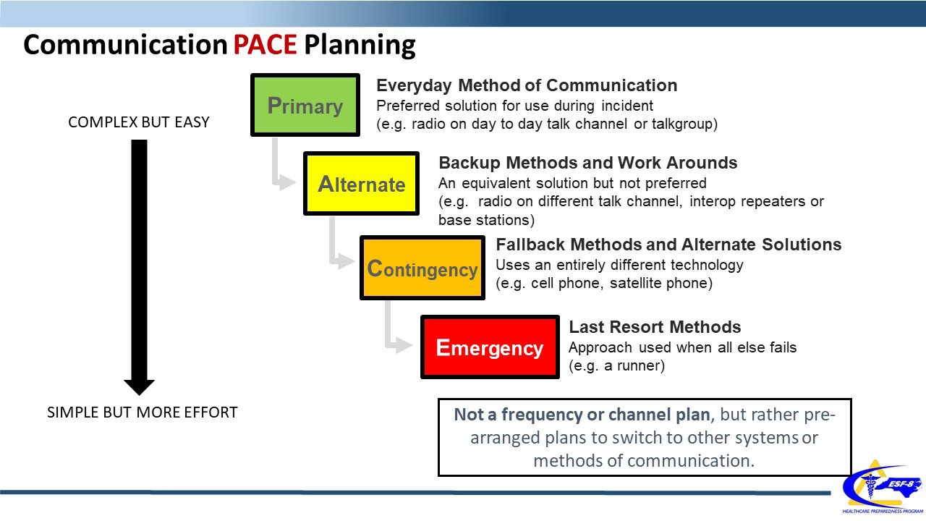
This MUST BE part of your P.A.C.E. planning

Slide 18


A National Standard for Deployable Trunking
COMING SOON
Currently Region 20 has three members active on the APCO National Standards Committee for Deployable Trunking
We will have a Deployable Trunking Site on Wheels Trailer - on site at APCO the whole week in Baltimore.
The unit will be live on the air in the convention center.
Personnel are encouraged to bring their portable radios and confirm operation on a system that fully meets the proposed national standard.

Slide 19
Bringing it all together
Region 20 has created a Guide to use of the Region 20 Interoperable Template, This is available to all anyone who wants it.
We highly encourage ALL public safety and public service entities to adopt the R20 template into your radios
We are happy to meet with any stakeholders to explain the need, the focus and the reason for this template.

Slide 20
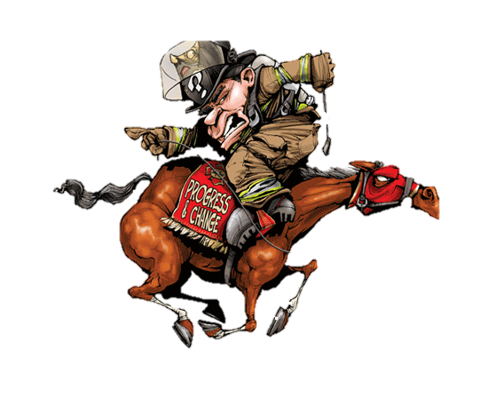


Questions?
Mike Baltrotsky: Region 20 RPC Chair @
michael.baltrotsky@montgomerycountymd.gov
michael.baltrotsky@mcfrs.org
michael.Baltrotsky@ncrcig.org
chair@rpc20.org

